Slide 1
NEMATODES
DR SOWMYA R.S.G
DEPT OF PATHOLOGY AND MICROBIOLOGY
SKHMC

Slide 2
General characters:
Unsegmented, cylindrical structure
Body covered with tough cuticle
Possess body cavity
Alimentary canal is complete
They are diecious

Slide 3
Female worms are divided into
Viviparous
Oviparous
Ovo- vivparous

Slide 4
Life cycle
In one host – man
Except in filaria and dracuncula where insect host is needed

Slide 5
Modes of infection
Ingestion - of embryonated egg
Penetration of skin
Blood sucking insect
Inhalation of dust contain egg

Slide 6
Classifi cation
INTESTINAL :
Small intestine-
Ascaris lumbricoides
Acylostoma duodenale
Trichinella spiralis
Caecum and appendix-
Enterobius vermicularis
Trichuris trichura

Slide 7
SOMATIC NEMATODES
LYMPHATIC SYSTEM
Wuchereria bancrofti
Brugia malayi
SUBCUTANEOUS TISSUES
Loa loa
Oncocerca volvulus
Dracunculus medinensis
LUNGS
Strongyloides stercorilis

Slide 8
Diagnosis - Intestinal nematodes
Egg in perianal skin
Larva in stool
Egg in stool
Coloured egg
A. lumbricoides
T. trichura
Colourless egg
A. duodenale
E. vermicularis

Slide 9
ASCARIS LUMBRICOIDES

Slide 10
The common round worm
Geographical distribution:
Tropics, India, china, south east asia
Global mortality 20,000 and morbidity is 10,00,000

Slide 11
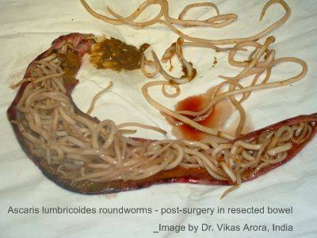
HABITAT
Adult worm lives in small intestine( jejunum)

Slide 12
MORPHOLOGY
ADULT WORM
Grayish white cylindrical worm
Anterior end is bent slightly dorsally
Buccal capsule has 6 teeth
Body cavity Contains irritating fluid- irritant action-substance(ascaron)
Life span in human host is less than a year

Slide 14
Morphology of adult worm :
MALE
length- 15- 25cm; diameter-3-4mm
Tail end- curved ventrally in the form of hook having a conical tip
Tail end posses 2 spicules,( copulatory organ)

Slide 15
FEMALE
length- 25-40cm; diameter- 5mm
Posterior extremity- conical and straight
At the posterior 1/3 of body there is a constriction called vulvar waist. Posses the vagina
Can liberate about 200,000 eggs daily.

Slide 16
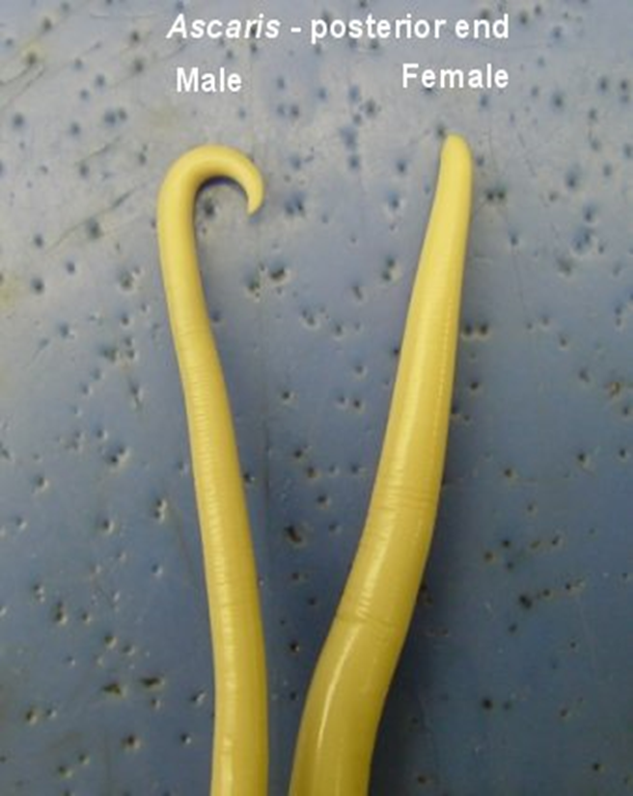

Slide 17
EGGS:
Characteristics of fertilized egg:
-Round or oval, bile stained and brownish in colour,
thick smooth translucent shell, unsegmented ovum,
floats in saturated solution of common salt.

Slide 18
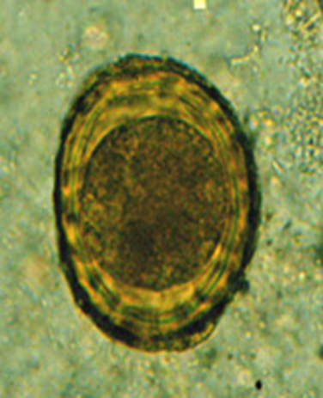

Slide 19
Characteristics of unfertilized egg:
Narrower, longer and more elliptical; brownish in colour;
Thinner shell with an irregular coating of albumin; small atrophied ovum;
Does not float in salt solution

Slide 21
LIFE CYCLE
No intermediate host required
Definite host- man
STAGES:
Stage 1- eggs in faeces - fertilized eggs containing the unsegmented ovum – passed with faeces; when freshly passed not infective
Stage 2- Development in soil – rhabditiform larva develops in 10 – 14 days

Slide 22
Stage 3- Infection by ingestion and liberation of larvae – upper part of small intestine
Stage 4- Migration through the lungs – burrow the intestine goes to liver – live 3- 4 days – go to heart and reach lungs

Slide 23
Stage 5- Re- entry into the stomach and the small intestine – crawl up from alveoli – trachea –bronchus- larynx – pharynx and swallowed
Stage 6- Sexual maturity and egg liberation - swallowed larva matures in 6 – 10 weeks

Slide 25
Pathogenesis
Mode of infection - By swallowing ripe Ascaris eggs with raw vegetables
Contaminated water supplies
Inhalation of desiccated eggs in the dust

Slide 26
INFECTING AGENT : Embryonated egg
PORTAL OF ENTRY : Alimentary canal
MIGRATION OF LARVAE : through lungs
SITE OF LOCATION : Small intestine

Slide 27
IMMUNOLOGY
Antibodies liberated during moulding period of the larvae produce protective antibodies
Severe allergic reaction
Eosinophilic count increased

Slide 28
PATHOGENICITY AND CLINICAL FEATURES
Symptoms divided into two groups:
Symptoms due to migrating larvae:
- Larvae in the lungs: Ascaris pneumonia(LOEFFLER’S SYNDROME); fever, cough, dyspnea; sputum blood tinged; urticarial rash and eosinophilia

Slide 29
-larvae in general circulation:
If they pass beyond the pulmonary capillaries and reach general circulation it can produce unusual clinical symptoms and also disturbances due to their presence in the brain, spinal cord, heart and kidneys.

Slide 30
2) Symptoms due to adult worms:
Incubation period: 60 to 75 days
Pathogenesis: adult worm produce its pathogenic effects in following ways:
(a) Spoliative action: by robbing the host of its nutrition; observed in hyperinfected in children- produce PEM. Also cause vitamin A deficiency(night blindness)

Slide 31
(b) Toxic action: body fluid when absorbed is toxic gives rise to typhoid like fever, also produce allergic manifestations such as urticarial, oedema of the face, conjunctivitis and irritation of the upper respiratory tract.

Slide 32
(c)Mechanical effects:
1. occurrence of intussusception
2. penetrate through the ulcers of the alimentary canal
3. Intestinal obstruction by forming a bolus(young children)

Slide 33
ECTOPIC ASCARIASIS
Worms migrate – enter stomach – may be vomited out or pass through the oesophagus at night ; during migration it accidently enters into the respiratory passage causing suffocation by blocking the rima glottides or even enter into a bronchus.

Slide 34
wandering ascaris – enter lumen of an appendix – cause appendicitis
If they enter biliary passage- obstructive jaundice and acute haemorrhagic pancreatitis; sometime penetrates high up in liver causing one or more abscess.

Slide 35
LABORATORY DIAGNOSIS
DIRECT EVIDENCES:
a) Finding of adult worms
- in the stool or vomit
- x-ray - diagnosis-demonstrated by radiography with barium emulsion, ingested by the worm within 4 to 6 hours- casts an opaque shadow( string like shadow)

Slide 36
(b) Finding of eggs
-in the stool: can be easily detected by a direct microscopical examination of a saline emulsion of the stool. Concentration by floatation method may be employed for the detection of eggs in the stool. Unfertilised eggs do not float in salt solution
-in the bile: microscopical examination of the bile obtained by duodenal intubation may reveal ascaris eggs.

Slide 37
II. INDIRECT EVIDENCE:
Blood examination - at early stage of invasion-eosinophilia ; in intestinal phase- associated strongyloidiasis or toxocariasis.
Dermal reaction (allergic)- “scratch test” with powdered ascaris antigen found to be positive.
Serological test – useful in diagnosis of extra intestinal ascariasis.

Slide 38
PROPHYLAXIS
Measures consist of :
- proper disposal of human faeces
- treatment of parasitized individuals
- education of children in schools on sanitary laws and hygiene.

